Slide 1


Slide 2
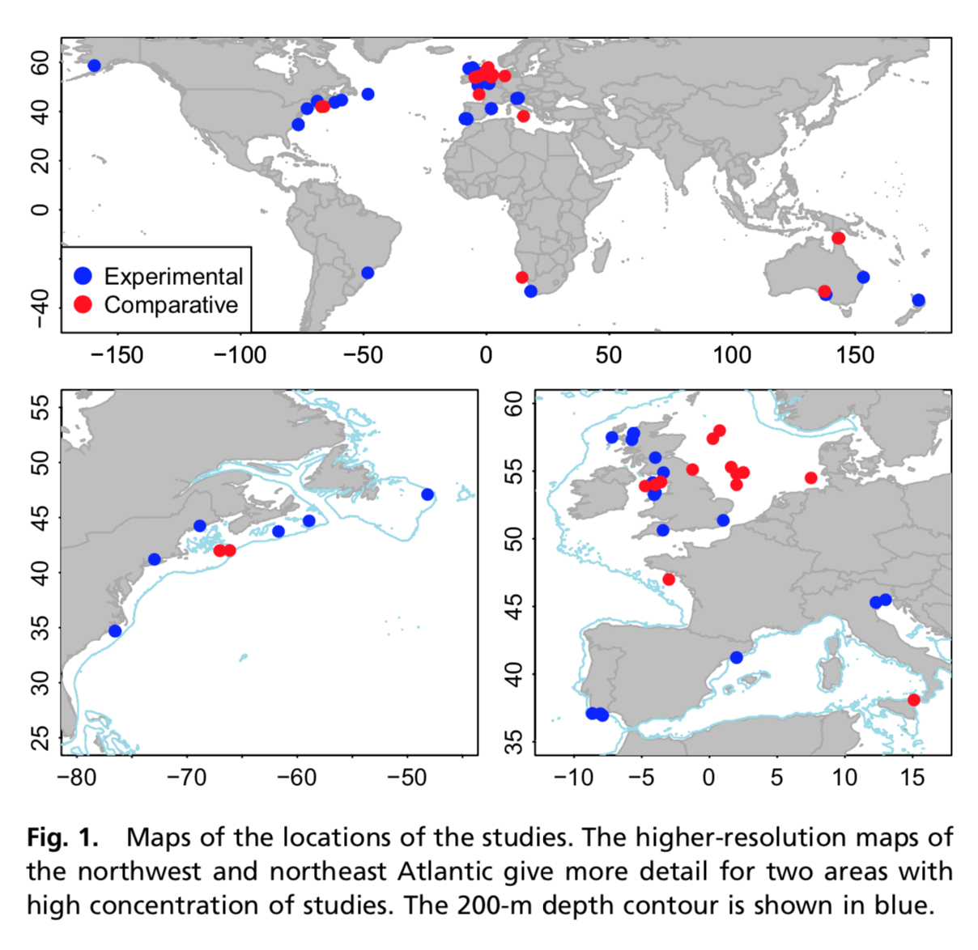
Metaanalysis –
Depletion
experimental studies of trawling impacts to estimate depletion of biota after trawling
Recovery rate
large-scale comparative studies of trawling effects on fishing grounds to estimate recovery rates of seabed biota

Slide 3
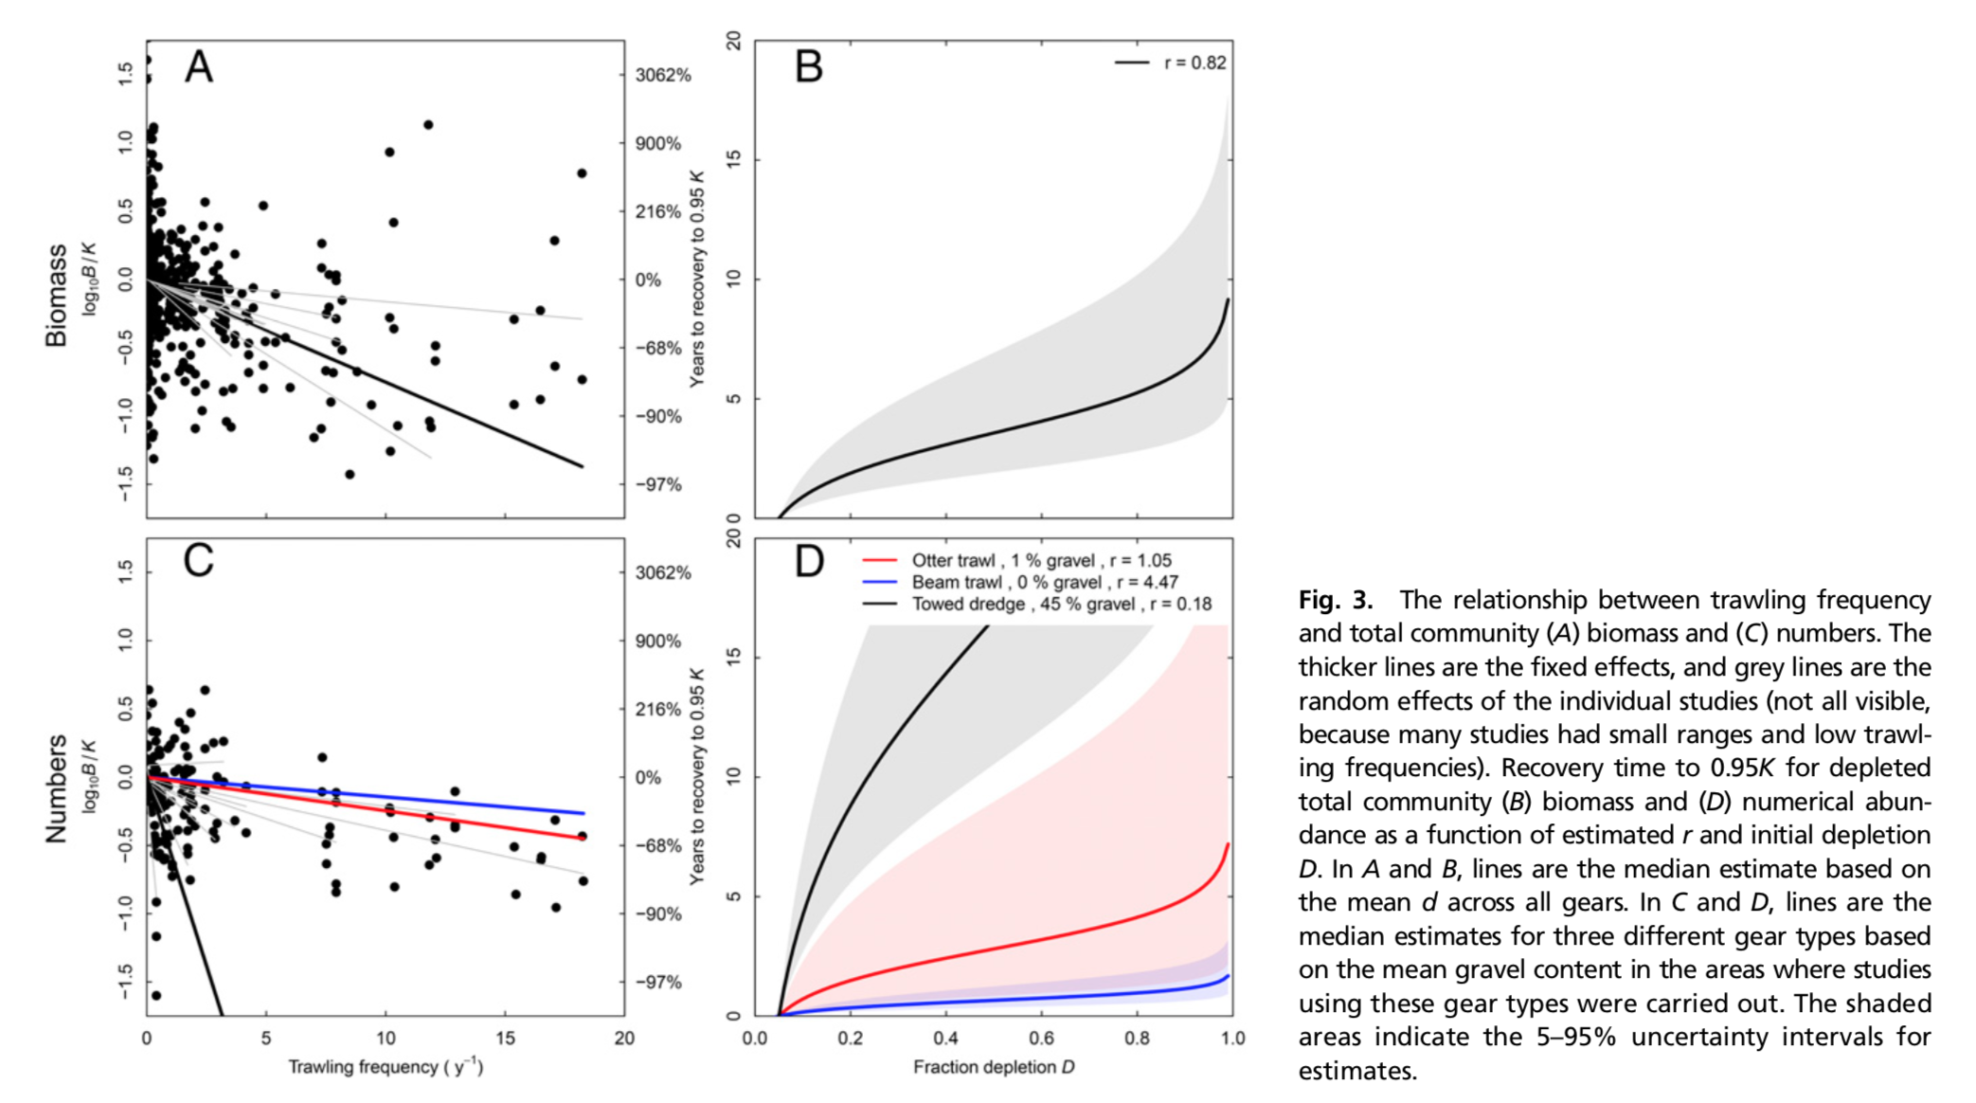
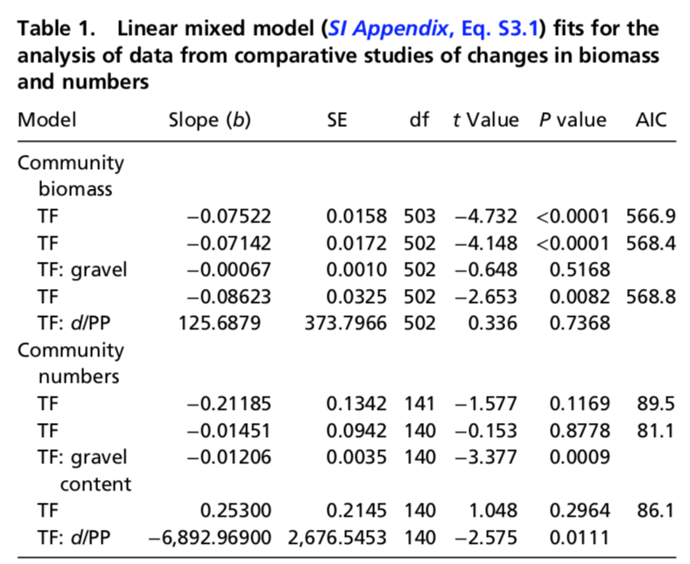
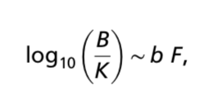

Slide 4
Defining the linear mixed effects model
Fixed effects vs. random effects
Why we need the intercept?

